Slide 1

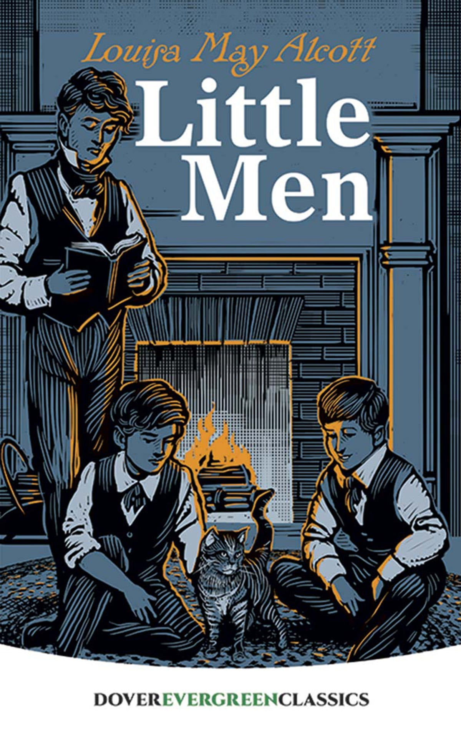
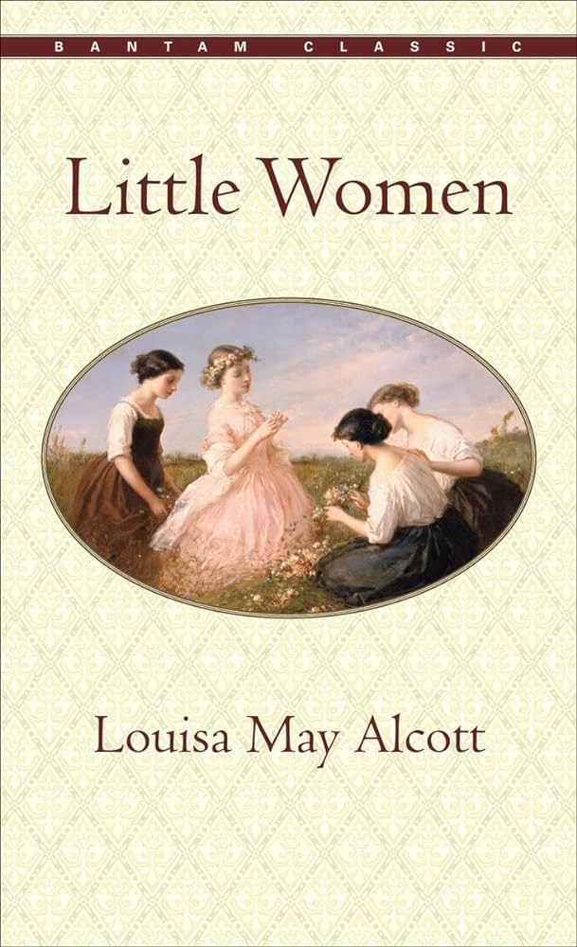
PRONOUN WARS: GENDERED LANGUAGE SHOWDOWN IN MID-1800S LITERATURE
A Spark NLP Project
Alaina Holland and Jonathan McGechie
July 25, 2024

Slide 2

OBJECTIVE/ METHODOLOGY
Objective
Aim: Determine if there's a statistically significant difference in the frequencies of subject and object pronouns for feminine and masculine pronouns in historical texts.
Explore: Investigate whether the author's gender influences these results.
Goal: Shed light on gender bias and representation in mid-19th century literature.
Importance
Reflects societal norms: Understanding gendered language in literature reveals and reinforces societal biases.
Historical Insight: Examining mid-1800s texts provides context for gender representation.
Contemporary Relevance: Inform current discussions about gender bias in media and literature.
Context:
Analyzing "Little Women," "Little Men," and "Moby-Dick."
Understanding gender representation in mid-1800s literature.
METHODOLOGY
Datasets:
"Moby-Dick" by Herman Melville
"Little Women" and "Little Men" by Louisa May Alcott
Technologies:
SparkNLP: For advanced natural language processing.
PySpark: For large-scale data processing.
Steps:
Text Preprocessing: Clean and tokenize text.
Part-of-Speech Tagging: Identify personal pronouns and their grammatical roles.
Pronoun Frequency Analysis: Calculate frequencies of subject (e.g., he, she) and object (e.g., him, her) pronouns.
Statistical Testing: Perform chi-square tests to determine statistical significance.

Slide 3

HYPOTHESIS
Hypothesis 1: Author’s Gender Influences Pronoun Usage
"Little Women" will have a higher frequency of feminine pronouns.
"Moby-Dick" will have a higher frequency of masculine pronouns.
Null Hypothesis (H0): There is no significant difference in the frequency of masculine and feminine pronouns between the texts.
Alternative Hypothesis (H1): There is a significant difference in the frequency of masculine and feminine pronouns between the texts.
Hypothesis 2: Gender Narration Perspective Impacts Pronoun Usage
"Little Women" and "Little Men" will show different feminine pronoun usage patterns due to different narrative perspectives.
Null Hypothesis (H0): There is no significant difference in feminine pronoun frequency between "Little Women" and "Little Men".
Alternative Hypothesis (H1): There is a significant difference in feminine pronoun frequency between "Little Women" and "Little Men".

Slide 4
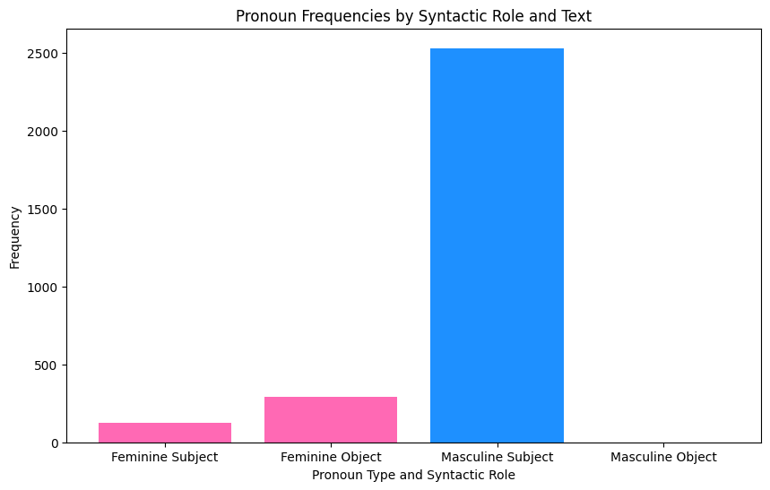
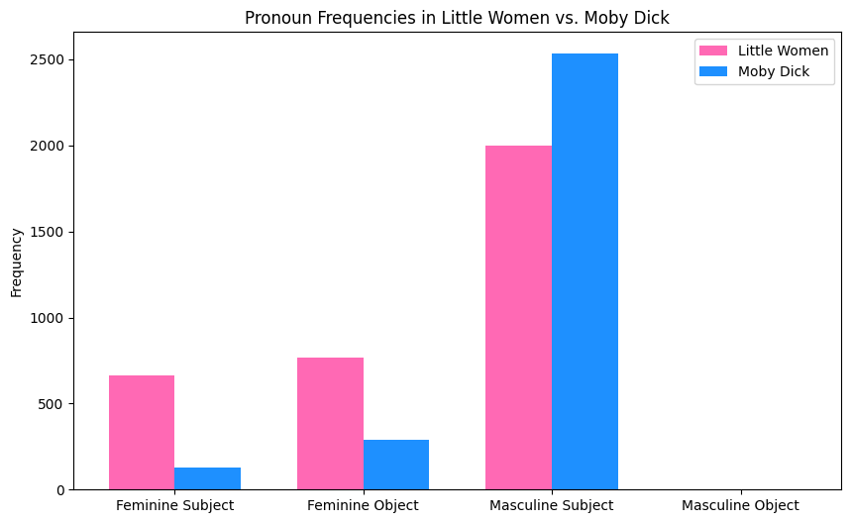
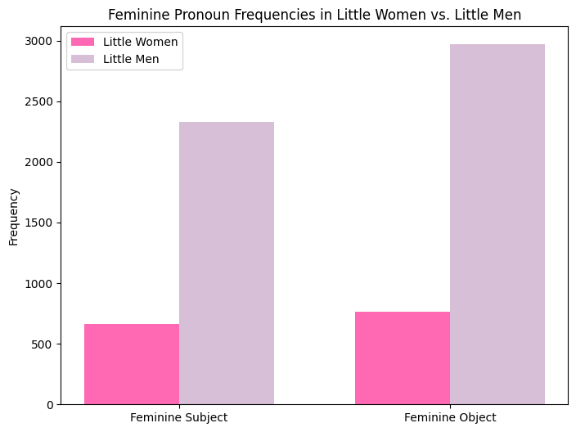
EVALUATION
Overall Pronoun Usage
Chi2 Statistic: 1947.796335480638
P-value: 0.0
Little Women vs. Moby-Dick
Overall Pronoun Usage:
Chi2 Statistic: 607.79
P-value: 1.0457e-132
REJECT THE NULL
Little Women vs. Little Men
Overall Pronoun Usage:
Chi2 Statistic: 2.63
P-value: 0.1045
FAIL TO REJECT THE NULL
Hypothesis 1: Author’s Gender Influences Pronoun Usage
Null Hypothesis (H0): There is no significant difference in the frequency of masculine and feminine pronouns between the texts.
Alternative Hypothesis (H1): There is a significant difference in the frequency of masculine and feminine pronouns between the texts.
Hypothesis 2: Gender Narration Perspective Impacts Pronoun Usage
Null Hypothesis (H0): There is no significant difference in feminine pronoun frequency between "Little Women" and "Little Men".
Alternative Hypothesis (H1): There is a significant difference in feminine pronoun frequency between "Little Women" and "Little Men".
Notes:
Interpretation: Significant difference in overall pronoun usage between "Little Women" and "Little Men."

Slide 5
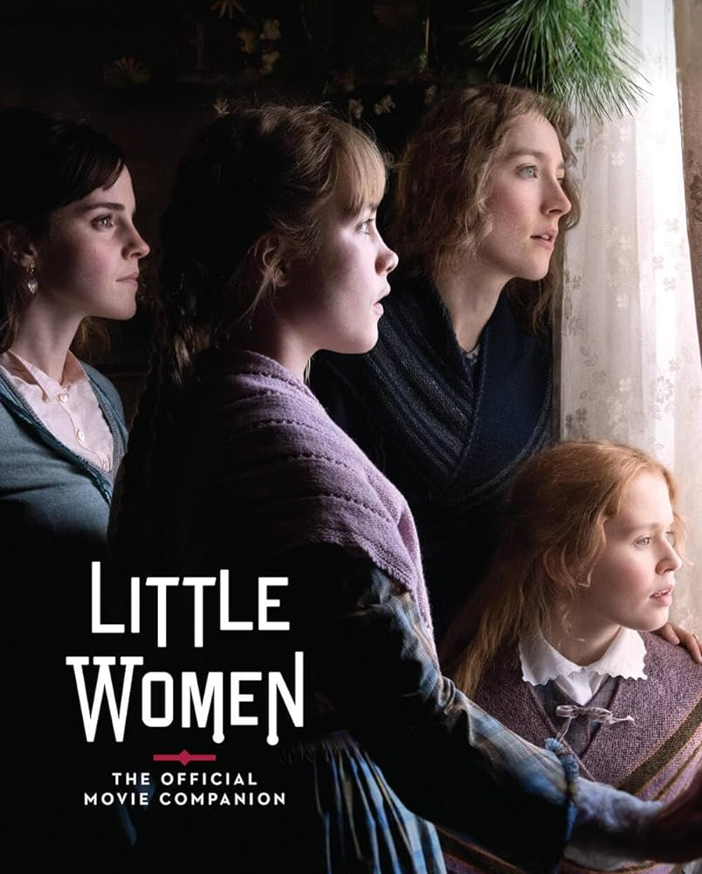
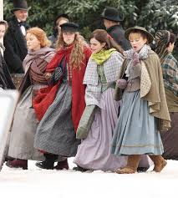


CONCLUSION
Findings:
Significant differences in pronoun usage were found between "Little Women," "Little Men," and "Moby-Dick."
The absence of masculine object pronouns in all three works reflects the narrative styles and societal norms of the time.
"Moby-Dick" shows a male-centric narrative, while "Little Women" and "Little Men" highlight female experiences.
Implications:
These differences underline how gender and societal norms influenced literature in the mid-1800s.

